Slide 1
The world of Web Development
By James Berck

Slide 2

https://46qasb3uw5yn639ko4bz2ptr8u-wpengine.netdna-ssl.com/files/2015/11/internet-map-FB.jpg

Slide 3
Scope of presentation
Web Application Architecture
Methods of Communication
Classical Server
Node.js Server
Why use it
Architecture
Types of Authentication

Slide 4
Web Application Architecture
Composed of two parts:
Client: Code in the browser, responsible for presenting app
Server: Computer located elsewhere, stores info and logic.
Data transported with Transmission Control Protocol (TCP)
https://en.wikipedia.org/wiki/Client%E2%80%
93server_model

Slide 5
Methods of Communication
Hypertext Transfer Protocol (HTTP)
Standardized data transfer and manipulation
Client makes request to the server
Web Socket
Enables bi-directional communication
http://www.xoriant.com/blog/web-2-0-social-
networking/websocket-web-stateful-now.html

Slide 6
Classic server
Handles requests from client in a single thread
Frozen by computationally heavy requests
Requires thread maintenance to use multiple threads
Different languages in server and client
Can use static languages

Slide 7
Node.js server
Processes server code on single thread, but handles intensive operations asynchronously.
Thread safe, no maintenance required
Uses JavaScript across the stack
Not a static language

Slide 8
Node.js architecture
Request made by client
Event placed in event queue
Event Loop Processes event
Event Loop hands off blocking operations to Thread Pool
Event Loop continues processing events
When thread pool is finished with event, put it’s callback in event queue
Event loop eventually processes callback
https://www.linkedin.com/pulse/nodejs-event-loop-
padmanabhan-pillai

Slide 9
Authentication, what is it?
Authentication is the process of verifying the identity of an individual
Usually performed by submitting a user name and a password that only a given user should know.
Three types: Cookie based, JSON Web Token based, and HTTPS

Slide 10
Cookie Based Authentication
Stateful method of communication maintained on server.
Uses a session ID to communicate with client
Session ID stored as a cookie on the client
A Cookie is just a key, value pair.
https://scotch.io/tutorials/the-ins-and-outs-of-token-based-authentication

Slide 11
JSON Web Tokens (JWT)
Stateless method of communication
Protected routes can be accessed by valid corresponding JWT tokens
All info needed stored in JWT
Less communication with database
https://scotch.io/tutorials/the-ins-and-outs-of-token-based-authentication

Slide 12
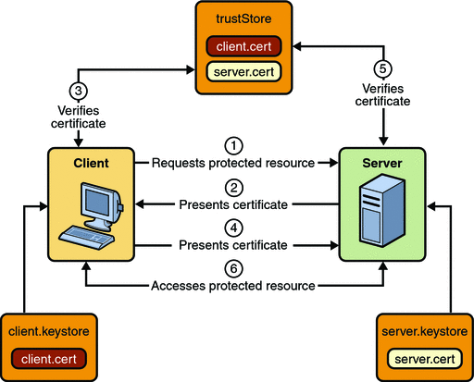
Hypertext Transfer Protocol Secure (HTTps)
Certified Authority (CA) issues certificates tied to identity
Verify other certificates with CA
Encrypts connection between them
Used for sensitive information such as credit card or SSN
https://docs.oracle.com/cd/E19226-01/820-7627/bncbs/index.html

Slide 13
Conclusion
Web is built on Server-Client relationship
Communicates via HTTP or Web Sockets
Classical Server
Node.js Server
Async is awesome
Event Loop
Authenticate with cookies, JWT’s or HTTPS

Slide 14
Questions?

